Slide 1
Blockchain Cryptography
Presented By: Amandeep Singh
CS 131 Discrete Structures

Slide 2
Cryptography
Cryptography is a method of allowing for secure communication in the presence of malicious parties.
The way this encryption works is through the use of an algorithm and a key. Algorithm is used to transform the plaintext into a ciphertext using the key.
Methods Observed in Class:
Julius Caesar Method
Translating a sentence/word to their respective number, and shifting it by a specific amount of characters.
“ACE” -> key of 3 (p+k) -> “DFH”
Cryptanalysis
A way of deciphering messages without knowledge of the method used and the key.
Frequency of letters
RSA Encryption
Two keys, public to encrypt data while private key decrypts data.
This prevents the need to share keys and allows for authenticity to be verified, and thus cannot be modified.

Slide 3
Uses of Cryptography?
Cryptography is of utter importance within the modern technological era which we live in.
Cryptography is used in a multitude of platforms:
Security systems
Personal Identifiable Information
Confidential Data
Document Tampering
Essentially every piece of technology within our disposal uses cryptography
It provides an extra level of security to much of our private information which we wouldn’t like to be leaked.
However one of the best application of cryptography can be seen through its application in e--commerce as one of the main reasons for the popularity of e-commerce is the anonymity and safety provided through these online transactions.
This can be seen through the use of cryptocurrencies.

Slide 4
Cryptocurrency
Cryptocurrency is a method of digital payment which simply relies on a peer-to-peer system to receive payments.
The largest cryptocurrency seen today is Bitcoin, due to the rather rapid transactions and the security of those transactions.
How is this possible?
Bitcoin is built off of a blockchain, which is simply a list of transactions which everyone can verify.

Slide 5
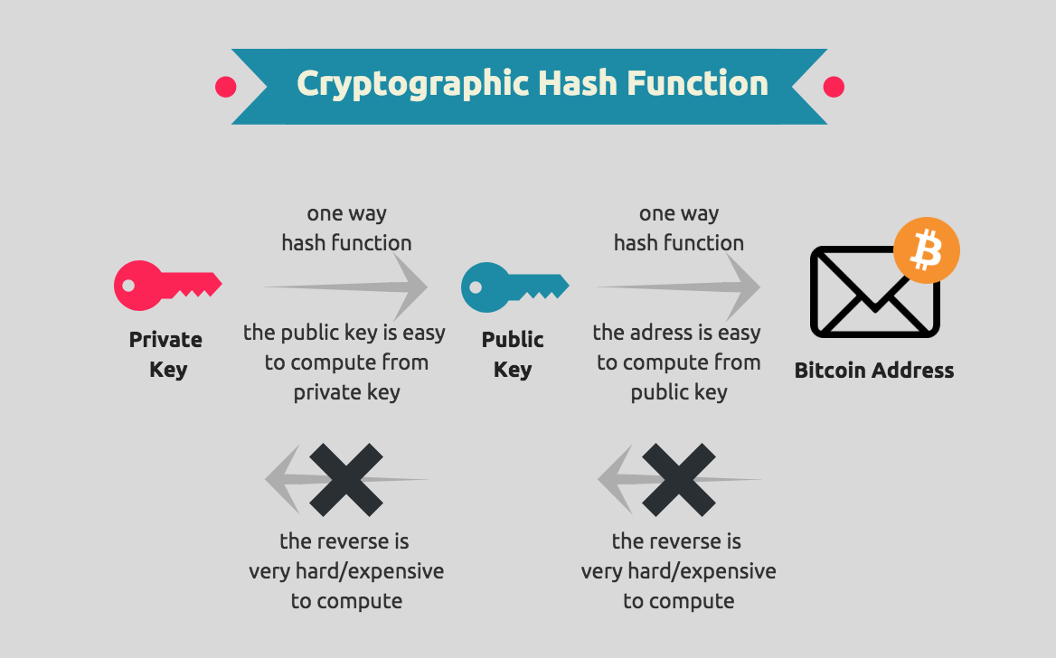
What is a Blockchain?
Blockchain is a distributed public ledger that contains a copy of every bitcoin transaction which can be accessed by everyone.
This makes it difficult to change the information, if one block in a chain is tampered with, it becomes obvious that it was being targeted.
Bitcoin uses a Secure Hashing Algorithm (SHA-256) which is a hash function and mining algorithm for Bitcoin.

Slide 6
How does a Blockchain work?
Block consists of three elements
Data - Information which is being used
Nonce - A 32-bit number created with every block
Hash - A cryptographic signature, takes a message and converts it into a fixed size
Chaining is the process of linking each block together
Each block contains a hash which refers to the hash of the previous block
Anytime the data of a block is altered, the hash of the block is also changed
Thus in order to alter data of one block, you must alter the data of all blocks
Overall this connects to the topic of cryptography because it is simply a process which converts information and data into an alternative text which is encrypted and secure.
It can only be accessed by the use of a key, allowing it to be accessed.
Essentially this takes what we’ve learned about cryptography to a unique application to the real world and see the complex yet importance of encryptions.

Slide 7
In Conclusion
Cryptography is a topic that is very prominent within the technological era which we live in.
Seen through our use of day to day devices or within tools which you use on a daily basis such as cryptocurrencies.
Through cryptocurrencies we seen the importance cryptography holds specifically through blockchains.
Devising methods of encryptions through the use of keys and peer to peer transactions which allows all data to remain secured.
Cryptocurrency plays a crucial role in understanding cryptography as it allows us to devise methods to prevent our information from malicious parties.

